Slide 1
Force Vectors Inclined Planes with Friction

Slide 2

Calculations involving Frictional Forces on an inclined plane

Slide 3
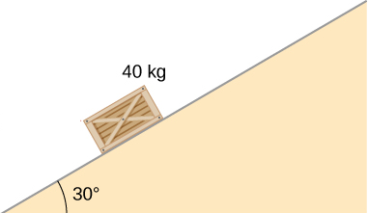
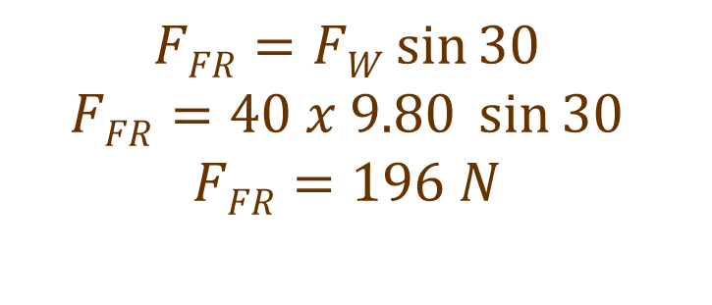
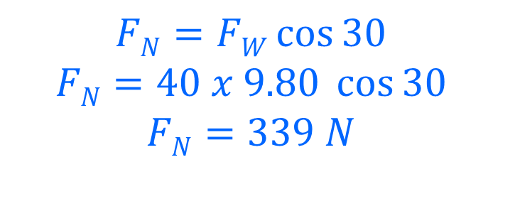
A 40 kg crate is resting on an inclined surface as shown. It is at rest.
F_{N}
F_{FR}
Draw a “free body diagram”, showing all of the forces acting on the crate.
F_{W}
Using a vector addition method, calculate the size of the friction force and normal force.
F_{FR}
$$FFR=FW\sin{30}$$
$$FFR=40 x 9.80 \sin{30}$$
$$FFR=196 N$$
F_{W}
F_{N}
30º
$$FN=FW\cos{30}$$
$$FN=40 x 9.80 \cos{30}$$
$$FN=339 N$$

Slide 4
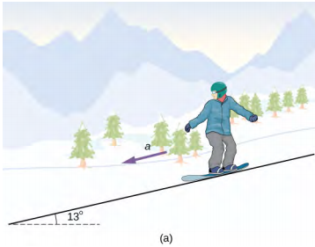
A snow boarder (85.0 kg) is going down a hill with a maximum frictional and air resistance force of 67.5 N.
Draw a free-body diagram to show the forces that are acting on the snow boarder.
Calculate the NET acceleration downhill.
How far downhill does the snow boarder go in 25 seconds?
What is their final velocity?

Slide 5
A snow boarder (85.0 kg) is going down a hill with a maximum frictional and air resistance force of 67.5 N.
Draw a free-body diagram to show the forces that are acting on the snow boarder.
Calculate the NET acceleration downhill.
How far downhill does the snow boarder go in 25 seconds?
What is their final velocity?
F_{N}
F_{FR}
F_{W}

Slide 6
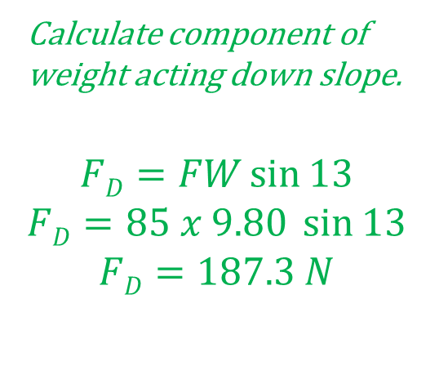
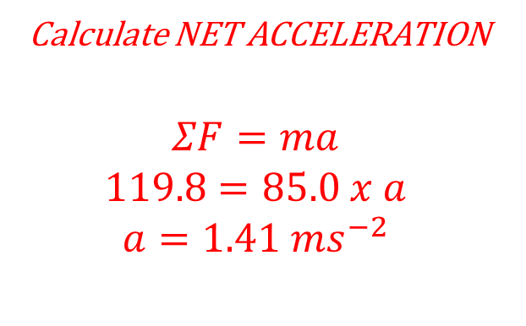
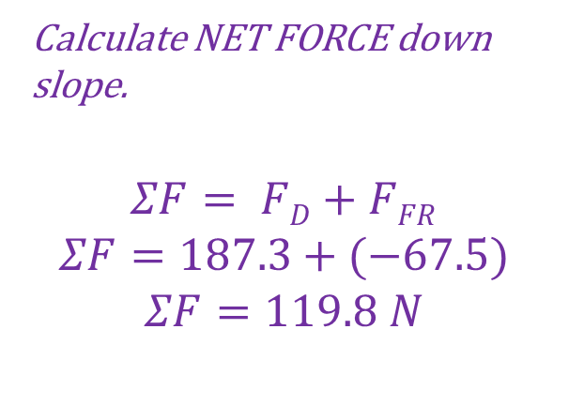
A snow boarder (85.0 kg) is going down a hill with a maximum frictional and air resistance force of 67.5 N.
Draw a free-body diagram to show the forces that are acting on the snow boarder.
Calculate the NET acceleration downhill.
F_{N}
F_{FR}
F_{D}
F_{W}
13º
Calculate component of weight acting down slope.
$$FD=FW\sin{13}$$
$$FD=85 x 9.80 \sin{13}$$
$$FD=187.3 N$$
Calculate NET FORCE down slope.
$$ΣF= FD+FFR$$
$$ΣF=187.3+(−67.5)$$
$$ΣF=119.8 N$$
Calculate NET ACCELERATION
$$ΣF=ma$$
$$119.8=85.0 x a$$
$$a=1.41 {ms}^{−2}$$

Slide 7
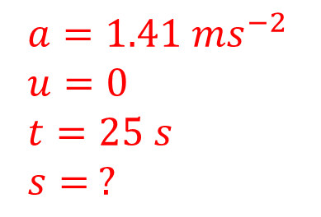
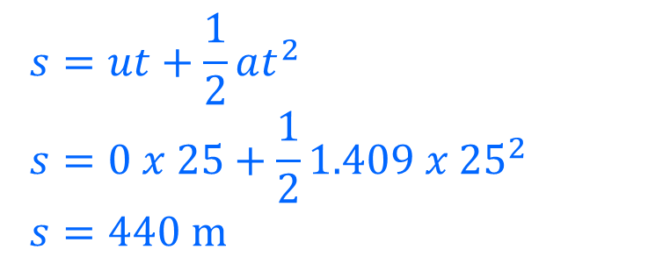
A snow boarder (85.0 kg) is going down a hill with a maximum frictional and air resistance force of 67.5 N.
Draw a free-body diagram to show the forces that are acting on the snow boarder.
Calculate the NET acceleration downhill.
How far downhill does the snow boarder go in 25 seconds?
F_{N}
F_{FR}
F_{D}
F_{W}
13º
$$s=ut+\frac{1}{2}at^{2}$$
$$s=0 x 25+\frac{1}{2}1.409{ x 25}^{2}$$
$$s=440 m$$
$$a=1.41 {ms}^{−2}$$
$$u=0$$
$$t=25 s$$
$$s= ?$$

Slide 8

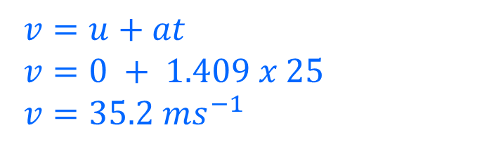
A snow boarder (85.0 kg) is going down a hill with a maximum frictional and air resistance force of 67.5 N.
Draw a free-body diagram to show the forces that are acting on the snow boarder.
Calculate the NET acceleration downhill.
How far downhill does the snow boarder go in 25 seconds?
What is their final velocity?
F_{N}
F_{FR}
F_{D}
F_{W}
13º
$$a=1.41 {ms}^{−2}$$
$$u=0$$
$$t=25 s$$
$$v= ?$$
$$v=u+at$$
$$v=0 + 1.409 x 25$$
$$v=35.2 ms^{−1}$$

